Slide 1
MAT 350 Engineering Mathematics
Fall 2025
Lesson -2
Variable Separable with Modelling
Exact ODE
Mohammad Sahadet Hossain, PhD
Professor
Department of Mathematics and Physics
North South University

Slide 2



First Order Ordinary Differential Equations:
Separable Equations: Chapter 2.2
A first-order differential equation of the form
is said to be separable or to have separable variables, and the equation is called separable equation.
Examples:
(1)
(2)
(3)

Slide 3

First Order Ordinary Differential Equations:
Separable Equations:
Solution Technique: When a first order ODE is separable variables, the solution can be found by integration, such that
where p(y)=1/ h(y)

Slide 4

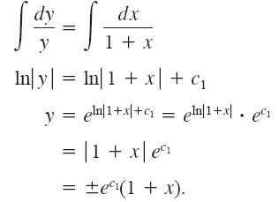
First Order Ordinary Differential Equations:
SOLUTION: Dividing by (1+x)y, we can write
from which it follows that

Slide 5




First Order Ordinary Differential Equations:
Separable Equations:
Solve
Solution: We obtain by side-changing
This means the ODE is separable. Then by integration,
If an initial condition y(0)=1 in introduced with the ODE, then we find the value of the constant c, which gives c=1.

Slide 6

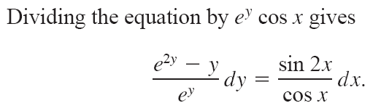

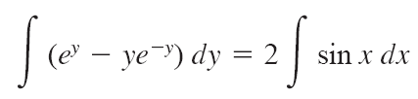


First Order Ordinary Differential Equations:
Using identity
, and integrating by parts
The solution is:

Slide 7


Slide 8







Exercise 2.2, Zill
Solution: Hints
Integrating both sides,
Substituting the initial condition
+

Slide 9
Solve:

Slide 10
Exercise: 2.2
Page-51
Problem#7,9,11,13,15,18,24,25,36

Slide 11




First Order Ordinary Differential Equations:
Reduction to Separable Form:
Certain non-separable ODEs can be made separable by transformations that introduce for y a new unknown function.
Suppose,
Here, f is any (differentiable) function of y/x. The form of such an ODE suggests that we substitute
u=y/x
Thus,
, and
Substituting into the above ODE gives,
Use method of Sep. Vari., and back substitute

Slide 12

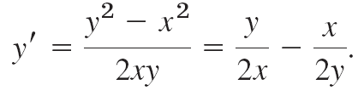



First Order Ordinary Differential Equations: Reduction to Separable Form:
Solution: We
Now substituting, u=y/x, or
and
Separable

Slide 13



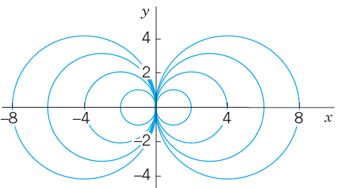


Integrating,
Taking exponents on both sides,
Note: Multiply both sides of the solution by x² ,
Thus,

Slide 14

Reference Book: 2

Slide 15






Separable Equations:
MODELLING: Population Dynamics (Chapter-3.1)
In Malthusian model , if P(t) denotes the total population at time t, then this assumption can be expressed as
where k is a constant of proportionality.
Integrating,
where P0 = e^{c}

Slide 16
Separable Equations: Population Dynamics
In a primary experiment, let the population of insects be N₀. At time t=4 hours, the population is seen to be 2N₀.
If the growth rate of the insects is proportional to the population of insects at certain time, how many hours later the population of the insects will be 8 times of the current population?
Solution:
Here, N₀ is the population at time t=0.
At time t=4 hours, the population is seen to be 2N_{0.}
Hence,
Hence, required time (T) for the population of the insects will be 8 times of the current population is,

Slide 17
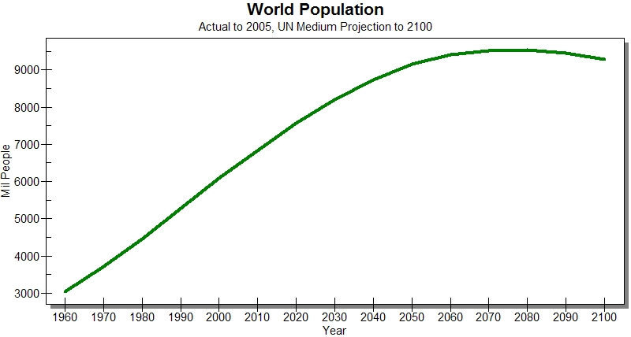
Separable Equations: Population Dynamics

Slide 18
Carbon Dating About 1950, a team of scientists at the University of Chicago led by the chemist Willard Libby devised a method using a radioactive isotope of carbon as a means of determining the approximate ages of carbonaceous fossilized matter.
This is the theory of carbon dating, which is based on the fact that the radioisotope carbon-14 is produced in the atmosphere by the action of cosmic radiation on nitrogen-14.
For his work, Libby was awarded the Nobel Prize for chemistry in 1960. Libby’s method has been used to date wooden furniture found in Egyptian tombs, the woven flax wrappings of the Dead Sea Scrolls, a recently discovered copy of the Gnostic Gospel of Judas written on
papyrus, and the cloth of the enigmatic Shroud of Turin. See Figure beside.

Slide 19
In physics the half-life is a measure of the stability of a radioactive
substance. The half-life is simply the time it takes for one-half of the atoms in an initial amount A0 to disintegrate, or transmute, into the atoms of another element.
Problem
For C-14, half-life is approximately 5730 years

Slide 20

Separable Variable

Slide 21







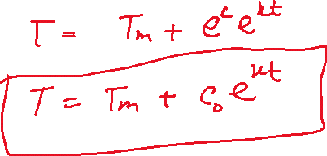





Slide 22



Separable Equations: Heating Office Building (Newton’s Law of Cooling)
Suppose that in winter the daytime temperature in a certain office building is maintained at 70°F. The heating is shut off at 10 P.M. and turned on again at 6 A.M.
On a certain day the temperature inside the building at 2 A.M. was found to be 65°F. Consider that the outside temperature varies between 50°F to 40°F by this time period. What was the temperature inside the building when the heat was turned on at 6 A.M.?
Solution: Let T(t) be the temperature inside the building and T_{m} be the outside temperature (we consider here T_{out} is the average of 50°F to 40°F, that is T_{m} = 45°F
General solution

Slide 23
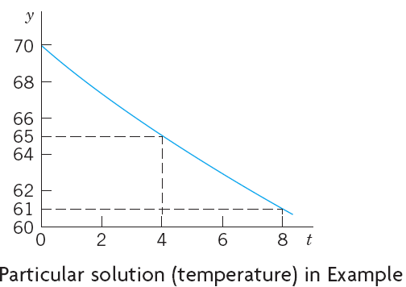






Separable Equations: Heating Office Building (Newton’s Law of Cooling)
Particular solution: We choose 10 P.M. to be t=0. Then the given initial condition is T(0)=70 and yields a particular solution, call it T_{p} . By substitution
We use T(4)=65, where t=4 is 2 A.M
Particular solution

Slide 24
Exercise 3.1
Problems :
3, 4, 5,6, 11

Slide 25
First-order differential equation:
EXACT EQUATIONS
(Chp- 2.4)

Slide 26


First-order differential equation: EXACT EQUATIONS
Definition: A first-order differential equation of the form
is said to be an exact equation if the expression on the left-hand side is an exact differential.
A differential expression M(x, y) dx + N(x, y) dy is an exact differential in a region R of the xy-plane if it corresponds to the differential of some function f (x, y) defined in R.
Criterion for an Exact Differential:

Slide 27


First-order differential equation: EXACT EQUATIONS
(1)
Solution Technique:
Consider M(x, y) dx + N(x, y) dy= 0, and
holds true.
Let a function f be the solution of (1), such that
(2)
We can find f by integrating M(x, y) with respect to x while holding y constant:
(3)
where the arbitrary function g(y) is the “constant” of integration.

Slide 28


First-order differential equation: EXACT EQUATIONS
Now differentiate (3) with respect to y and assume that
Hence,
(4)
Finally, integrate (4) with respect to y and substitute the result in (3).
The implicit solution of the equation is f (x, y) = c.

Slide 29
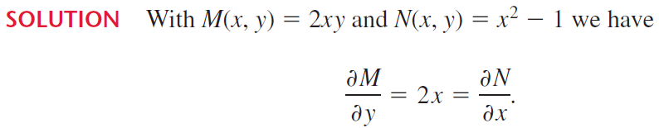
Thus the equation is exact.
The solution f(x,y) is given by

Slide 30


First-order differential equation: EXACT EQUATIONS
The partial derivative of the above f(x,y) with respect to y equal to N(x, y).
So, the solution is
Note: The explicit form of the solution is
easily seen to be y c(1 x2) and is defined on any interval not containing either x =1 or x= -1.

Slide 31






First-order differential equation: EXACT EQUATIONS
Exercise 2.4 (Zill)
Solution: Hints
Therefore,
Hence,

Slide 32


First-order differential equation: EXACT EQUATIONS
HW:
(1)
(2)
(3)
(4)
(5)

Slide 33
Exercise: 2.4
Porb# 9,12,13,18,21,22,28

